Slide 1

CTF Group 6/2/2021
Pwn2win CTF Recap & Scanning Tools
Before we get started: Pull up a vm with internet access and run:
Sudo apt install nmap

Slide 2
Pwn2Win, the hardest CTF of 2021 to begin with… Whoops!
Our two teams placed: 198 & 423 both solving 1 problem, based on time finished.
That being said, it still gives us a chance to look a bit closer at what CTFs include and are:
Post-CTF Write-ups
Typical Genres:
CTFTime & Rating system

Slide 3
General Thoughts from those who participated?
Stats about Pwn2win CTF:
720 Teams, 27 Challenges.
3 Unsolved Challenges, 7 with 5 or less solves
Sections included: Cryptography, Hardware, Web, Reverse Engineering, Pwning, Miscellaneous and Bonus
Web & Crypto had the most solves per challenge.
CTFTime rated at 83.41 which is the current highest of the 2021 year

Slide 4
We’ll review a few various challenges:
Illusion (WEB, 78 solves)
Oh, Anna Julia (CRYPTO, 49 Solves)
Dot’s Exposed (MISC, 33 solves)
After each CTF, teams can submit write-ups detailing the process in which they solved each problem. This is often required for top placing teams.
Illusion
Oh Anna Julia
Dot's Exposed
Rest of write-ups here: https://ctftime.org/event/1186/tasks/

Slide 5
Scanning tool: NMAP
Like many tools in cybersecurity, NMAP is an open source tool to explore a network by scanning ports, services, and hosts by sending and receiving packets. The responses to those packets are then used to gather information on the target.
It’s seen as one of the best tools in first step network analysis

Slide 6
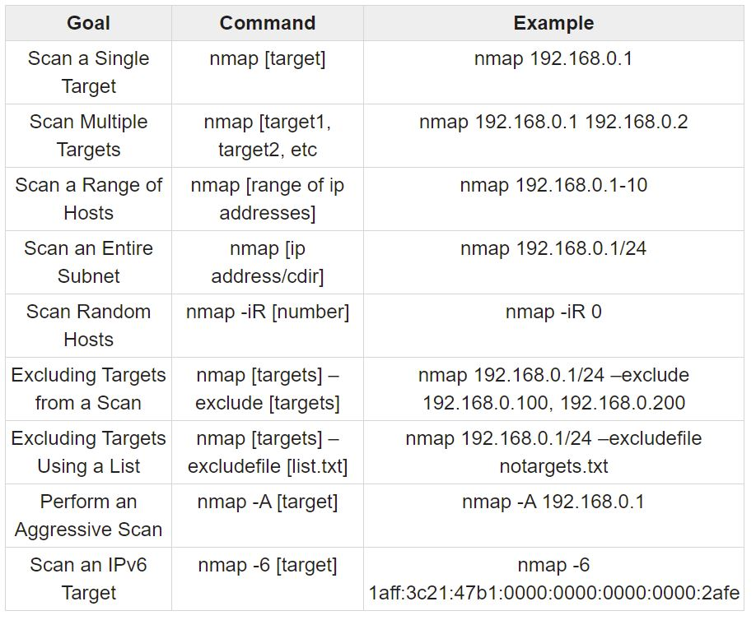
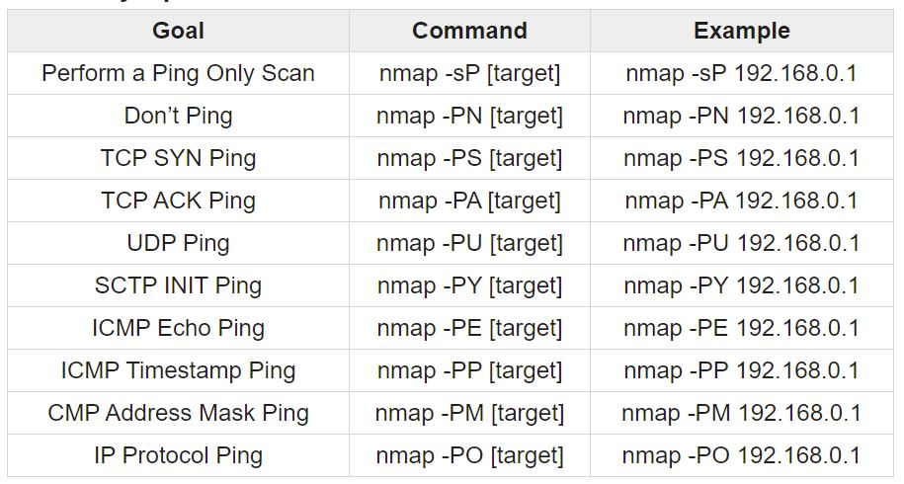
Basic NMAP Commands: 18.117.171.144 & 3.15.39.9

Slide 7
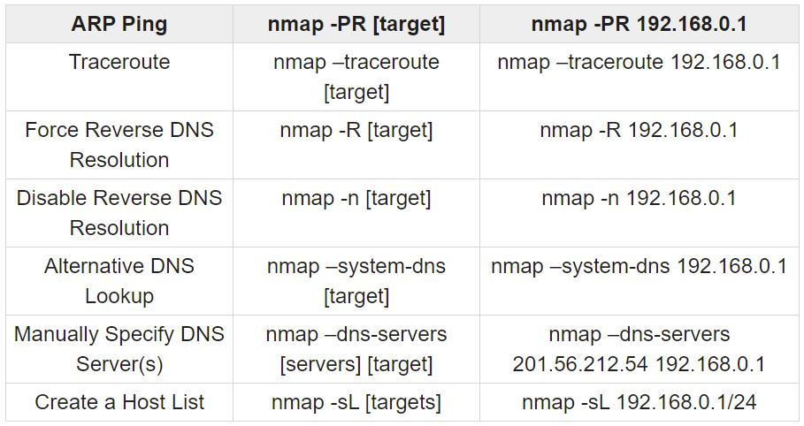
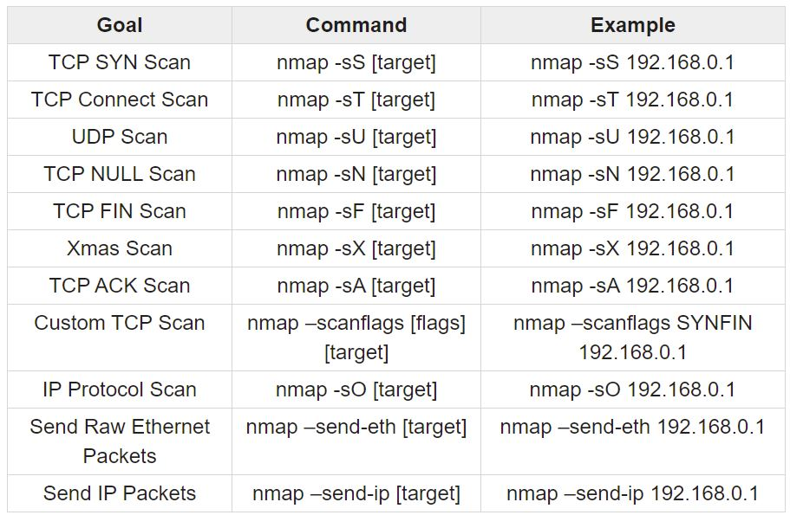
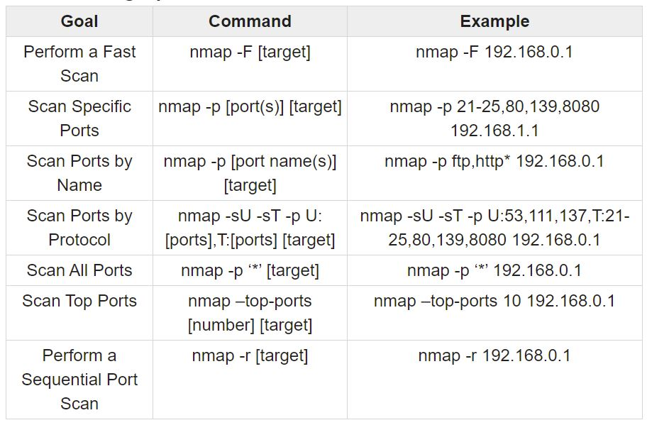

Slide 8
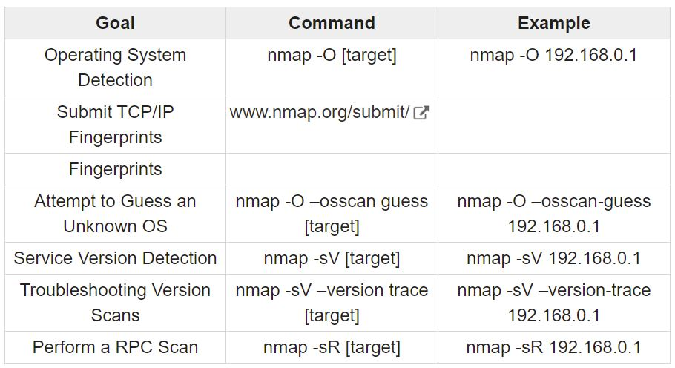
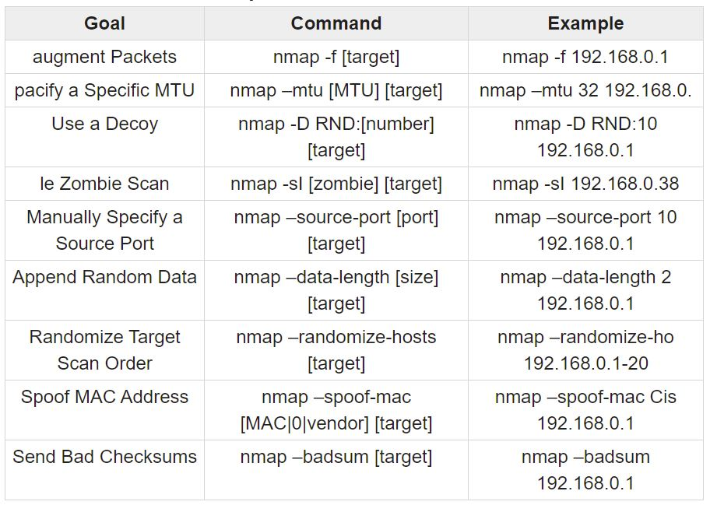
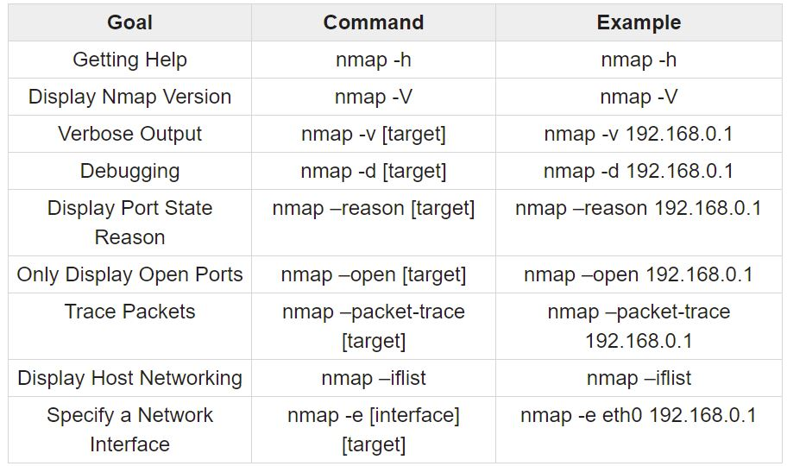

Slide 9
Additional resources and links
https://www.tutorialspoint.com/nmap-cheat-sheet
https://nmap.org/book/
https://youtu.be/4t4kBkMsDbQ
https://aws.amazon.com/security/penetration-testing/

